Slide 1
Welcome to The Electron Hotel

Slide 2
Hotel Organization
There are four types of rooms in the hotel.
s – simple $
p – pretty $$
d – deluxe $$$
f – fabulous $$$$
There are two single beds in each room.
This hotel assigns guests to bed, not just rooms.

Slide 3
Hotel Organization
There are four types of rooms in the hotel.
s – simple $
p – pretty $$
d – deluxe $$$
f – fabulous $$$$
There are two single beds in each room.
This hotel assigns guests to bed, not just rooms.

Slide 4
Hotel Organization
There are four types of rooms in the hotel.
s – simple $
p – pretty $$
d – deluxe $$$
f – fabulous $$$$
There are two single beds in each room.
This hotel assigns guests to bed, not just rooms.

Slide 5
Hotel Organization
Each floor has different number and types of rooms available.
4th floor
3rd floor
2nd floor
1st floor
s room
p rooms
d rooms
f rooms
s room
p rooms
d rooms
s room
p rooms
In general, the higher the floor, the more expensive the room.
s room

Slide 6
Assigning Beds to Guests
The ABC Element Company is using your hotel for a convention. The company has asked you to assign beds to their employees. And, of course, they want you to spend the least amount of money possible.

Slide 7
Assigning Beds to Guests
4th floor
3rd floor
2nd floor
1st floor
s room
p rooms
d rooms
f rooms
s room
p rooms
d rooms
s room
p rooms
s room
Notes:
Dialogue…
So, you start assigning beds to the employees starting with
the first floor S room, bed 1, bed 2 (Use a colored arrow to show where each guest is assigned.)
You put the next two employees on the second floor
S rooms
Then, the p rooms
Since this hotel charges by the bed, you can put the first three people into their own “pretty” room.
The next three get put into the extra bed in the “pretty” rooms.
This system works very easily until you get to the 3rd floor.
3S1, 3s2, 3p1 …3p6
Your boss tells you that instead of putting the next people into the 3d rooms, that the 4s room is actually less expensive.
So, you put them into the 4 s room, then into the 3d rooms.
Your boss says that since it is your first day, she will help you with this pricing chart to assign the beds to the guests, but tells you that you will eventually have to memorize this system. How are you ever going to do this?

Slide 8
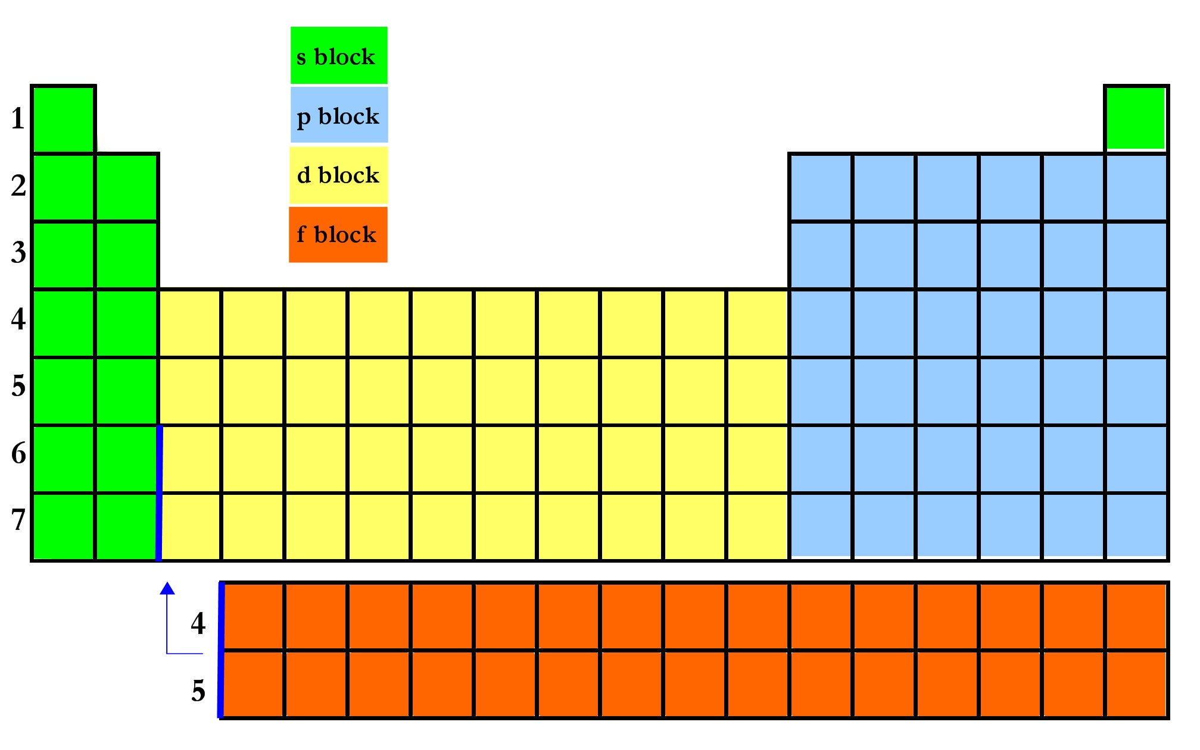
Assigning Beds to Guests
Notes:
Dialogue…
You are pretty sharp and you notice a picture on the wall. The boss says that the picture is just an old drawing by the architect of the hotel. But, you see more than just a drawing. You notice a pattern.
Talk about the order here. Label 1s1, 1s2, etc. as you talk.
The electrons of the elements in period 1 fill the 1s subshell. The electrons of the elements in period 2 fill the 2s and 2p subshells. The electrons of the elements in period 3 fill the 3s and 3p subshells. The electrons of the elements in period 4 fill the 4s, 3d, and 4p subshells. The electrons of the elements in period 5 fill the 5s, 4d, and 5p subshells. The electrons of the elements in period 6 fill the 6s, 4f, 5d, and 6p subshells. The electrons of the elements in period 7 fill the 7s, 5f, 6d, and 7p subshells.

Slide 9
Assigning Beds to Guests
Notes:
Let’s try using this system.
Think of each different element as a company and its electrons as the employees.
Place the employees of the Br company into rooms in the Electron Hotel.
Or, in chemistry terms, place the 35 electrons of Br into energy levels and sublevels.

Slide 10
Assigning Beds to Guests
This is known as the Aufbau principle. The Aufbau principle tells us that electrons fill up the orbitals that have the lowest energy first.
Notes:
Dialogue:
You obviously don’t need to memorize the order of the Aufbau principle. Just use the periodic table as your guide!

Slide 11
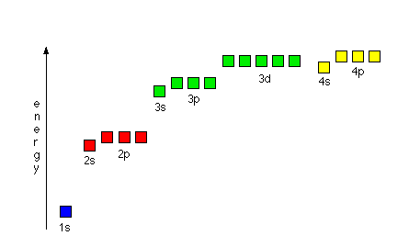
Notes:
Here is a visual diagram of the energy of each orbital.
You can use it to explain if you need it.

